Slide 1
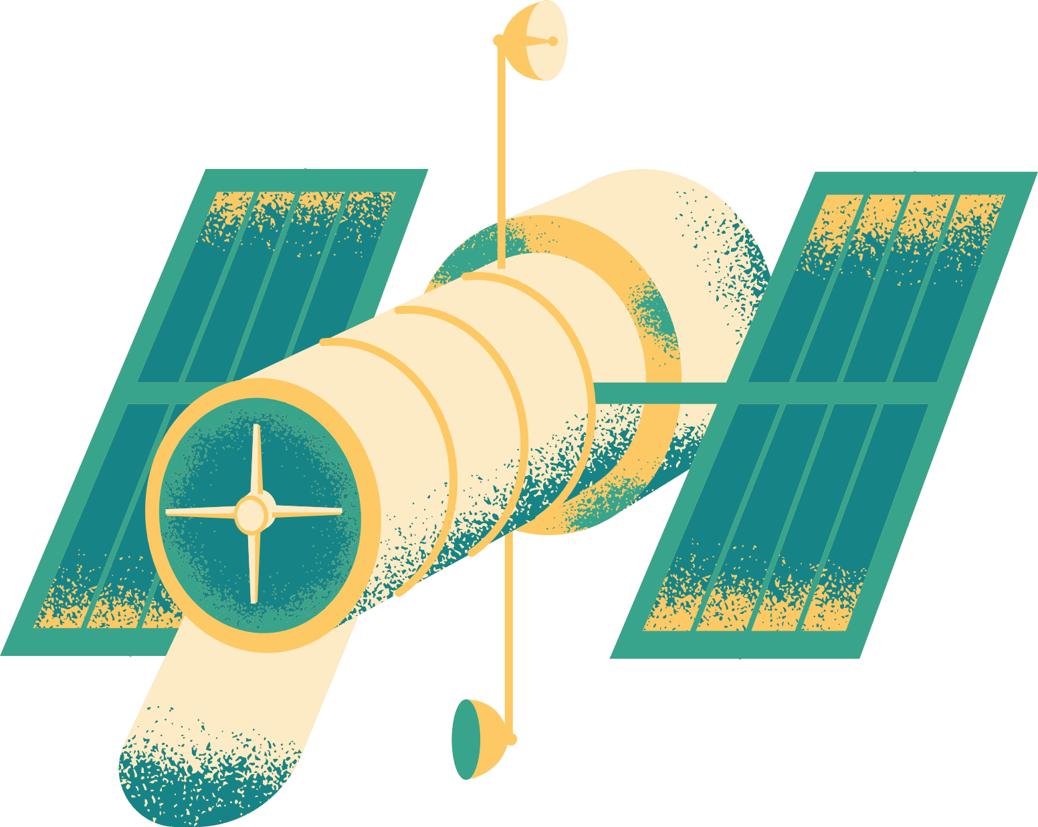
Satellite
Submitted to,
Dr. Nazrul Islam
Associate Professor, Dept of ICT,MBSTU
Presented by,
Name : Farzana Yeasmin Era
ID : IT-21054

Slide 2
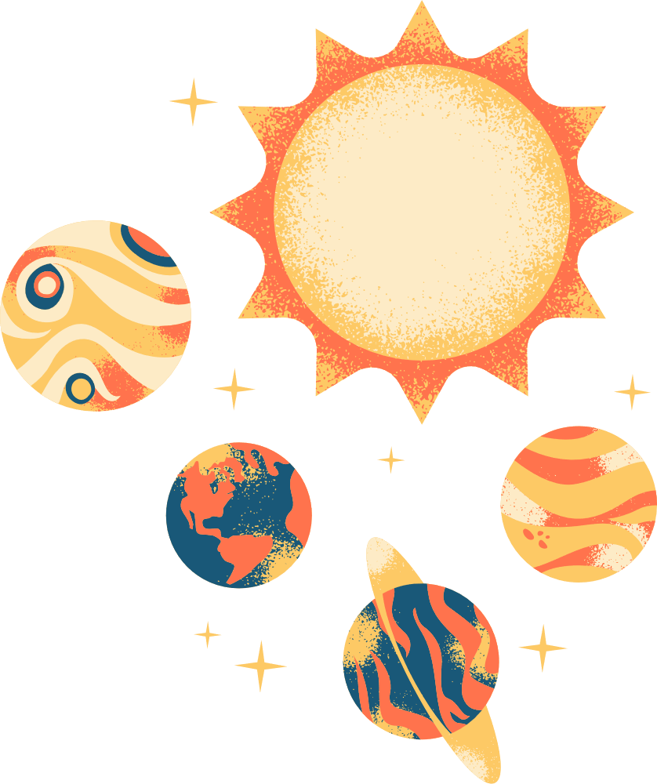
More Than Just Stars
When we look up at the night sky, we see stars and planets. But there's a whole fleet of human-made objects silently circling our planet. There are thousands of space satellites in orbit, and we use their data and services dozens of times every day, often without even knowing it.

Slide 3
What is a Satellite?
Simply put, a satellite is any object that orbits a larger object. The Moon is a natural satellite of Earth. A space satellite is a human-made machine launched into space to orbit Earth or another body. They are our "eyes and ears" in the sky, equipped with cameras, sensors, and transmitters.

Slide 4
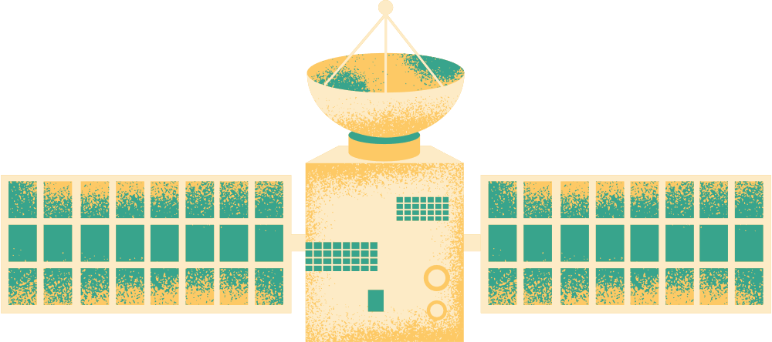

The Satellite Family
Satellites are specialized. Let's meet the key types:
EARTH OBSERVATION SATELLITES
COMMUNICATION SATELLITES
NAVIGATION SATELLITES (GPS)
SCIENTIFIC SATELLITES
The relay stations in the sky.
The planet's health monitors.
The global positioning system.
The cosmic detectives.

Slide 5
The Connectors: Communication Satellites
These satellites are essential for global connectivity.
What they do: Receive, amplify, and retransmit signals.
Applications: Live TV broadcasting, international phone calls, satellite radio, and providing internet access to remote and rural areas.

Slide 6
The Watchers:
Earth Observation Satellites
These satellites keep a constant watch on our planet.
What they do: Monitor weather patterns, track environmental changes, and map terrain.
Applications: Weather forecasting, disaster management (tracking hurricanes, wildfires), agricultural monitoring, and urban planning.

Slide 7

The Guides: Navigation Satellites (GPS)
The Global Positioning System (GPS) is a constellation of satellites that tells you exactly where you are.
How it works: Your phone or car receiver calculates its position by timing signals from multiple satellites.
Applications: Turn-by-turn navigation, aircraft and ship routing, precision farming, and location services on every smartphone.

Slide 8
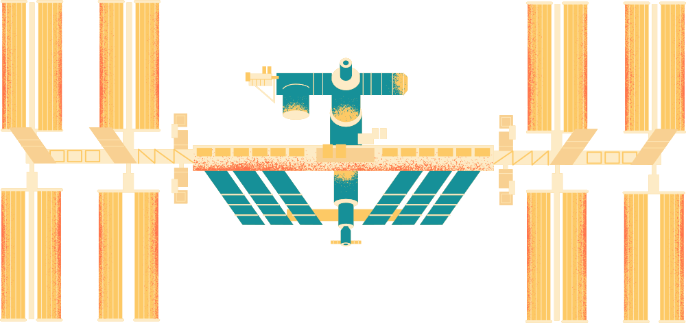
The Explorers: Scientific Satellites
These satellites look outward to unravel the mysteries of the universe or look back at Earth for scientific study.
What they do: Study cosmic phenomena, other planets, and fundamental physics.
Example: The Hubble and James Webb Space Telescopes study redshifted spectrum from distant galaxies to understand the expansion of the universe. Closer to home, scientific data is crucial for missions like the Mars rover, which relies on satellites orbiting Mars to relay its data back to Earth.

Slide 9

A Day Powered by Satellites
Let's imagine a typical day:
Morning: Check the weather forecast on your phone (Earth Observation).
Commute: Use GPS for traffic navigation (Navigation).
Evening: Watch a live international news broadcast (Communication) or use a mapping app to find a restaurant (Navigation).

Slide 10









resources page

